Slide 1

RAG-Enhanced Medical Chatbot for Health Insights
Presented by:
Sumit Kumar Mahato
Shivam Singh Patel Ingit Paul Debarghya Dutta
Under the guidance of:
Prof. Subhasis Dasgupta
Prof. Jaydip Sen

Slide 2
Introduction
AI-based chatbots are increasingly used in healthcare to assist patients and professionals.
However, LLMs can generate hallucinated outputs, posing risks in clinical applications. This project introduces a hybrid architecture combining RAG and LLMs, where RAG retrieves factual medical data, ensuring context-aware responses.
By leveraging retrieval-augmented generation, the system minimizes hallucinations and enhances accuracy in disease symptom extraction and remedy recommendations.

Slide 3
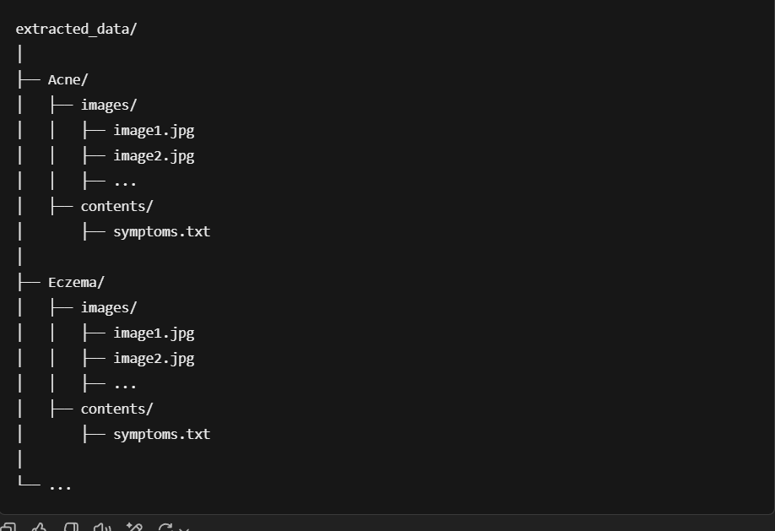
Extracted data file structure:

Slide 4
Business Objective
This project aims to develop an Chatbot diagnosis and recommendation system using Retrieval-Augmented Generation (RAG) and LLM.
The system takes an image of a skin condition and user-described symptoms as text.
Then, it generates a possible diagnosis along with remedies and recommendations.

Slide 5
Problem Statement
Challenges in Symptom-Based Diagnosis:
Patients struggle with identifying conditions based on symptoms.
Many existing AI chatbots lack multimodal understanding (text + image).
Traditional search-based methods are inefficient and unreliable.
Our project solve these problems by integrating images and textual data to enhance medical diagnosis.

Slide 6
Methodology
Collect and preprocess data – Extract images and text from DermNet for analysis.
Generate embeddings – Convert images and text into vector representations for efficient retrieval.
Store in ChromaDB – Insert the vectorized data into ChromaDB for fast and structured access.
Implement RAG framework – Use retrieval-augmented generation to fetch relevant information and provide accurate recommendations.

Slide 7
Models used and its purpose
1. Sentence Embedding Model: distiluse-base-multilingual-cased-v2
Why Used? Converts medical text into semantic embeddings for better search.
What It Does? Finds meaning-based similar medical texts instead of keyword matches.
2. Image Embedding Model: ViT-B/32
Why Used? Extracts deep features from medical images for analysis.
What It Does? Converts images into vector representations to enable similarity-based retrieval.

Slide 8
Models used and its purpose
3. Multi-Modal Embedding Model: CLIP-ViT-B/32
Why Used? Links images and text by creating aligned embeddings.
What It Does? Allows searching images using text queries and vice versa, improving cross-modal retrieval.
4. Large Language Model: Mistral-7B-Instruct-v0.3
Why Used? Generates accurate and context-aware medical responses.
What It Does? Uses retrieved data to answer queries and reduces hallucinations.

Slide 9
Models used and its purposes
5. Vector Database: ChromaDB
Why Used? Stores and retrieves semantic embeddings efficiently.
What It Does? Finds the most relevant disease-related text for each query.
6. Regex-Based Extraction: Regular Expressions (Regex)
Why Used? Extracts structured medical information (like symptoms, treatments, or conditions).
What It Does? Identifies key patterns in text for better data structuring.

Slide 10
Fine Tuning v/s RAG
Feature | Fine-Tuning | RAG (Retrieval-Augmented Generation)
Definition | Adapts a pre-trained model to a specific domain by updating its weights. | RAG enhances a model’s responses by retrieving relevant information from an external knowledge base before generating an answer.
Data Handling | Requires labeled training data and retraining for updates. | Uses a knowledge base, allowing dynamic updates without retraining.
How It Works | The model is trained on new labeled data, adjusting its parameters. | A retriever fetches relevant documents from an external knowledge base, and the LLM uses them to generate responses.
Computational Cost | Requires high-end GPU and processing time. | Lower (uses retrieval, avoiding full retraining).
Use Cases | Chatbots for specific industries, legal document analysis, financial forecasting. | Virtual assistants (e.g., AI-powered customer support), smart chatbots that retrieve real-time information, applications needing frequent updates (e.g., news summarization).

Slide 11
Fine-Tuning vs. RAG: Skin Disease Example
User Query: “What are the best treatments for eczema?”
Fine-Tuning Approach: "Eczema is commonly treated with moisturizers, topical steroids, and antihistamines." Issue: If the model was trained on older data, it won’t include newer treatments.
RAG Approach: "Recent studies (2024) suggest that biologics like Dupilumab have shown significant improvement in severe eczema cases. Consulting a dermatologist for personalized treatment is recommended." Advantage: RAG pulls the latest research-backed recommendations.

Slide 12
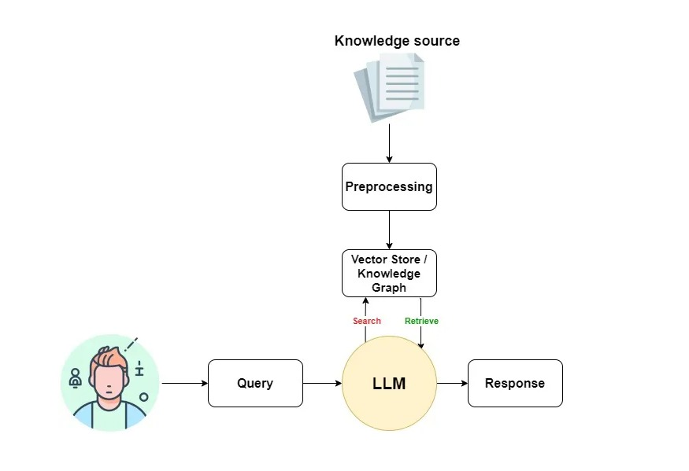
Generic workflow of RAG
Image from medium website:https://miro.medium.com/v2/resize:fit:720/format:webp/1*V2fIP5KCStvM8RJeUpAgSg.jpeg

Slide 13
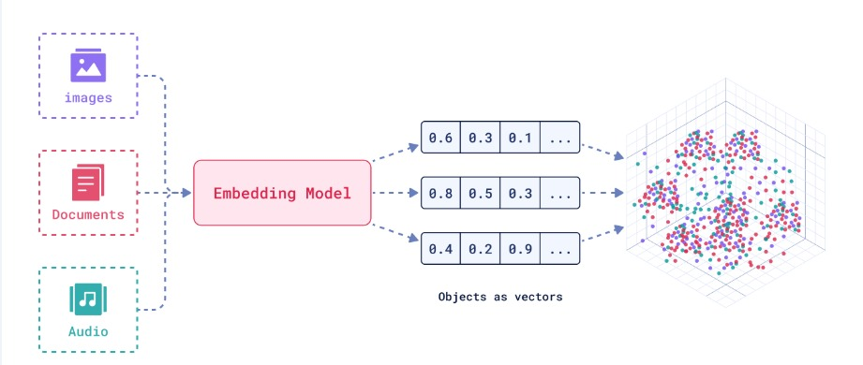
Embedding
What is Embedding? Embedding is the process of converting images or text into numerical vectors that capture their meaning and relationships in a high-dimensional space.
Image from medium: https://images.app.goo.gl/cbNzVpXULpKWrjm2A

Slide 14
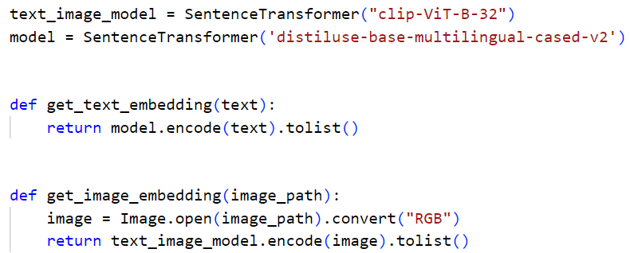
Image and Text Embedding
Text Embedding: Converts words/sentences into numerical vectors that capture semantic meaning, enabling efficient search and retrieval. (Example: "Skin rash" → Vector [0.12, 0.87, …])
Image Embedding: Transforms images into numerical representations that capture visual features like color, texture, and shape. (Example: An eczema image is mapped to a vector similar to related skin conditions.)

Slide 15
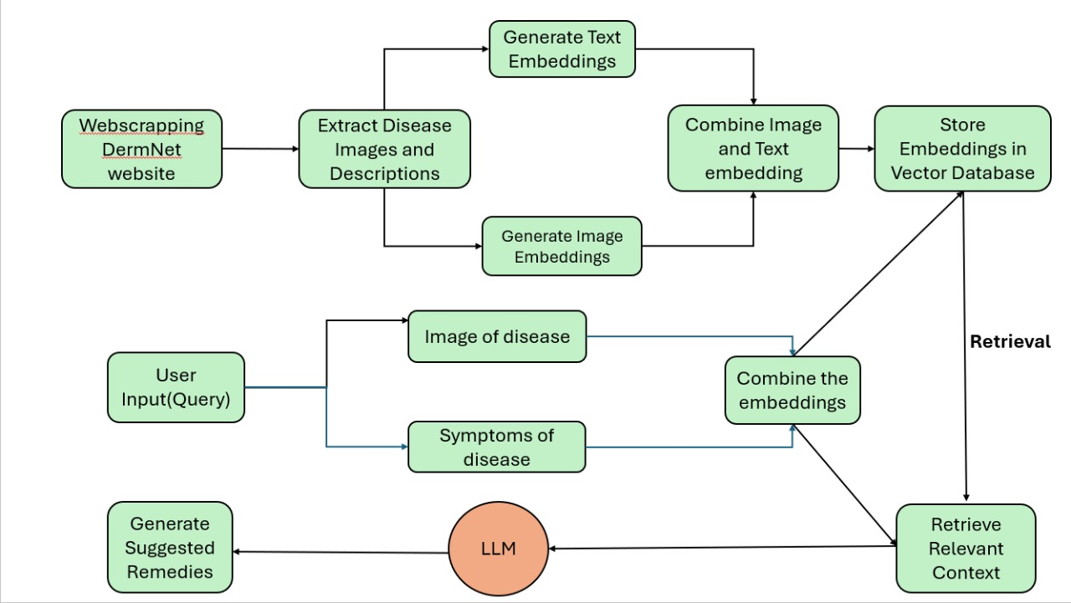
Process flow

Slide 16
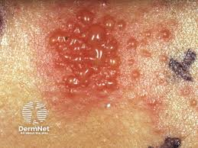
Input Query
Text query: "I have got an itchy rash and blisters at the site of my skin “
Image query:

Slide 17
Output Generated
Disease: nickel_allergy
Diagnosis and Recommendations:
Based on the symptoms provided, it is possible that the user may have a nickel allergy.
To confirm the diagnosis, the user should avoid contact with any objects that may contain nickel, such as jewelry, coins, or certain types of metal.
If the symptoms persist, the user should consult with a dermatologist for further evaluation and treatment.
In the meantime, the user can try using over-the-counter hydrocortisone cream to help alleviate the itching and inflammation.
The user should also avoid scratching the affected area to prevent further irritation and potential infection.
If the rash or blisters are severe, the user should seek immediate medical attention.

Slide 18
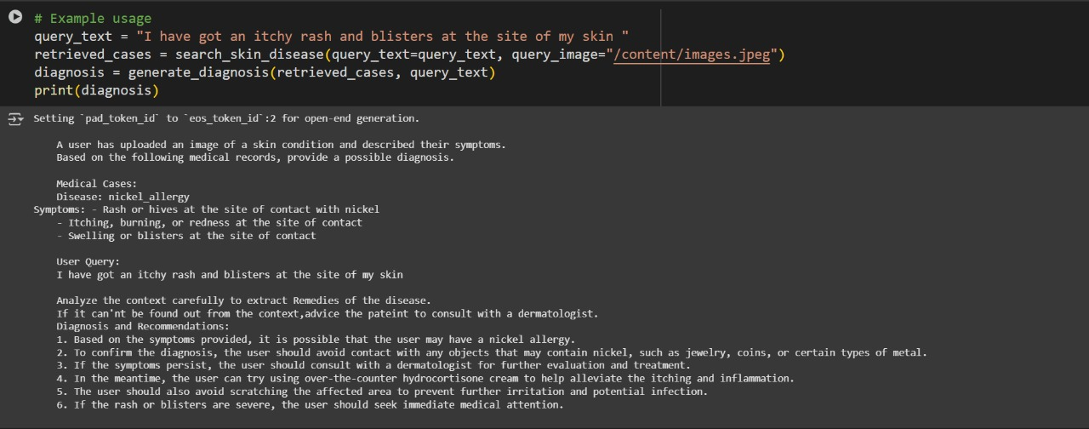

Slide 19
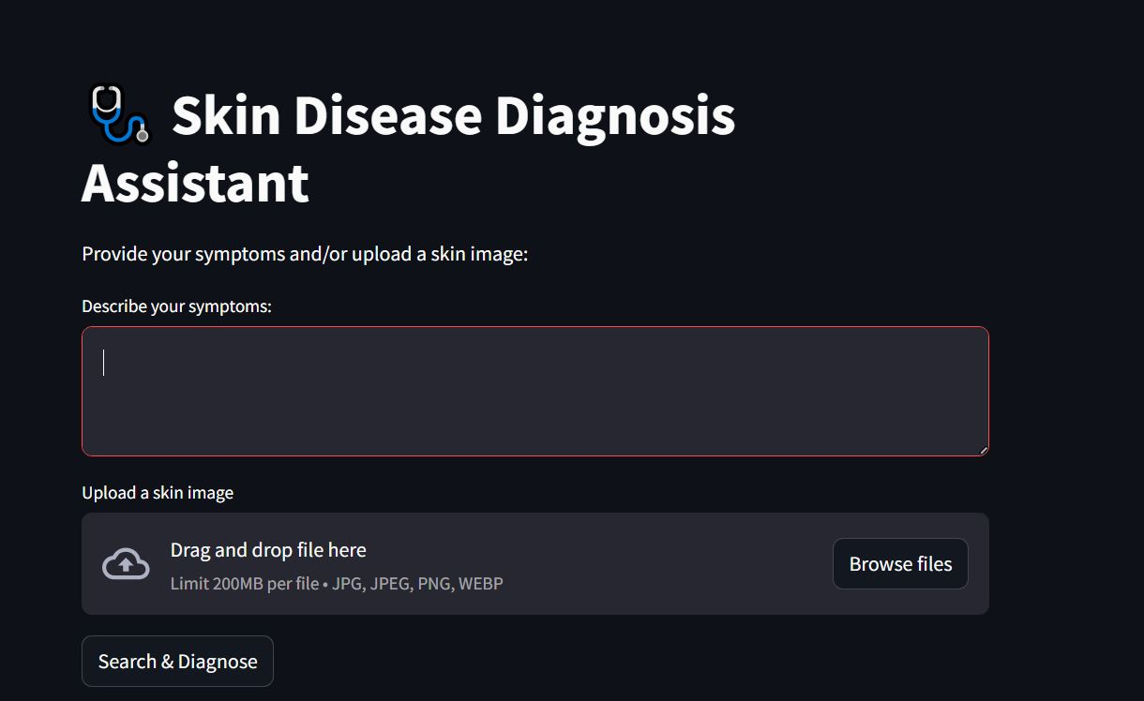

Slide 20
Challenges & Future Work
Challenges:
Ensuring dataset completeness and handling rare diseases.
Improving model accuracy for diverse skin tones and conditions.
Handling ambiguous or low-quality images.
Future Work:
Expanding the database with more diverse skin disease datasets.
Enhancing chatbot contextual understanding with larger LLMs.
Deploying the system as a mobile/web-based application.

Slide 21
Ethical Considerations & Limitations
Ethical Considerations
Data Privacy & Security — Ensure compliance (HIPAA GDPR), prevent unauthorized access.
Bias in Al Models — Diverse datasets needed to avoid biased predictions.
Transparency & Explainability — Show retrieved sources, confidence scores.
User Consent & Responsibility — Disclaimers: Not a substitute for doctors.
Limitations
Accuracy Issues — Al may misdiagnose ambiguous symptoms.
Rare Diseases — Limited training data affects performance.
Quality of Input Data — Poor images & vague symptoms reduce accuracy.
No Real-Time Doctor Validation — Al cannot replace physical examinations.+

Slide 22
Conclusion
Analyzing text and images for symptom extraction & remedy recommendation
Impact:
Improves accessibility to preliminary disease assessment.
Reduces dependency on immediate clinical consultation.
Enhances patient awareness and medical literacy.
Key Considerations:
Not a replacement for medical professionals.
Diagnosis & treatment validation require qualified medical experts
Data sources must be verified by medical professionals
Enhancing Performance:
A fine-tuned model on medical datasets
Integration with Agentic RAG for dynamic knowledge retrieval ensures context-aware, reliable, and medically verified responses

Slide 23
THANK YOU

